Slide 1
Computational visual Perception Project Part - 1
Winter – 25/26
Name : Siddhant Vishvendu Sharma

Slide 2
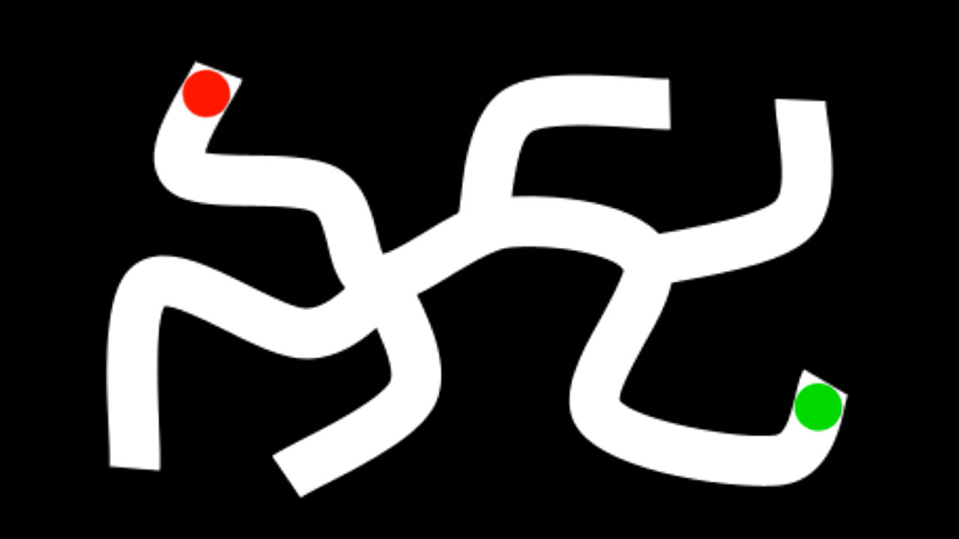
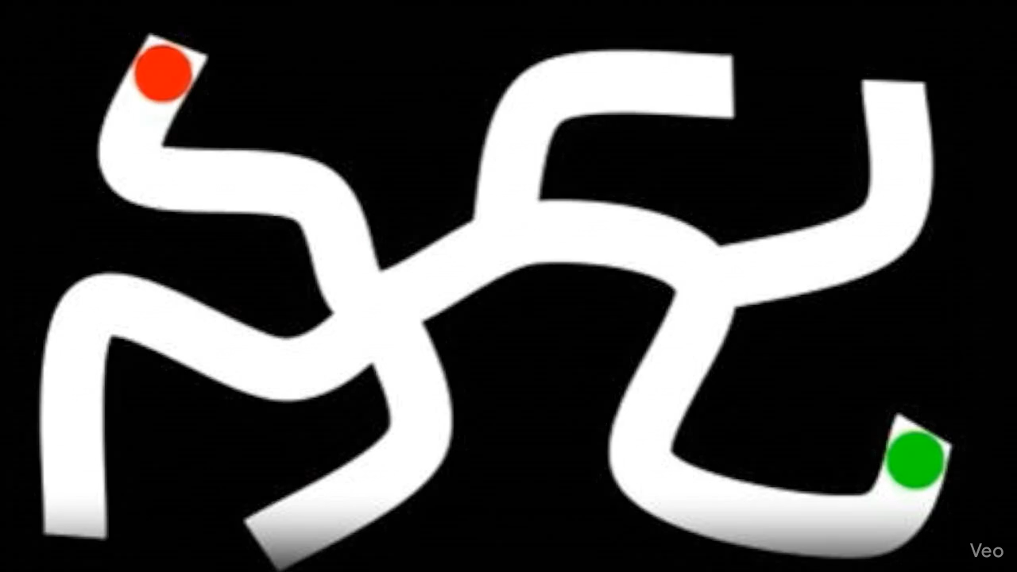
Task 1 : Maze Solving (Veo 3.1)
Prompt : “Create a 2D animation based on the provided image of a maze. The red circle slides smoothly along the white path, stopping perfectly on the green circle. The red circle never slides or crosses into the black areas of the maze.”

Slide 3
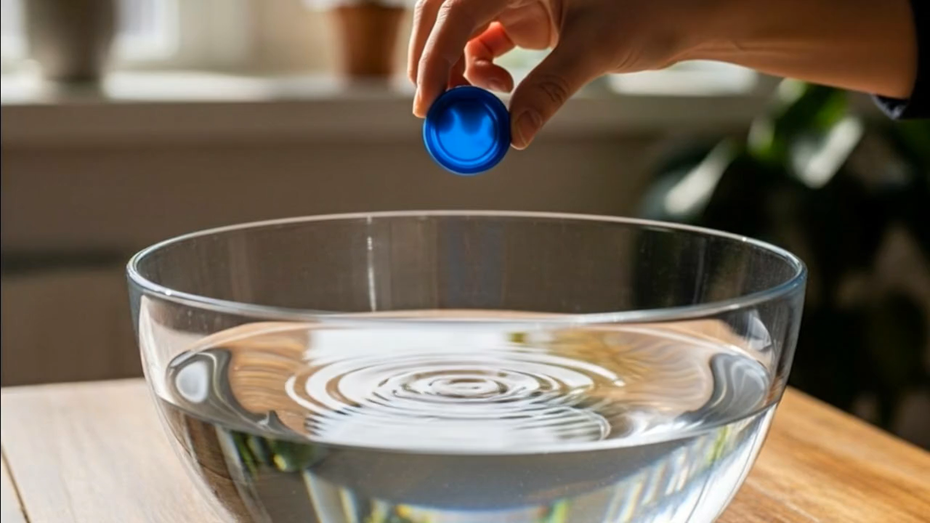

Task 1 : Physics (Veo 3.1)
Prompt : “The hand lets go of the object, the object falls in water. Static camera, no pan, no zoom, no dolly.”

Slide 4
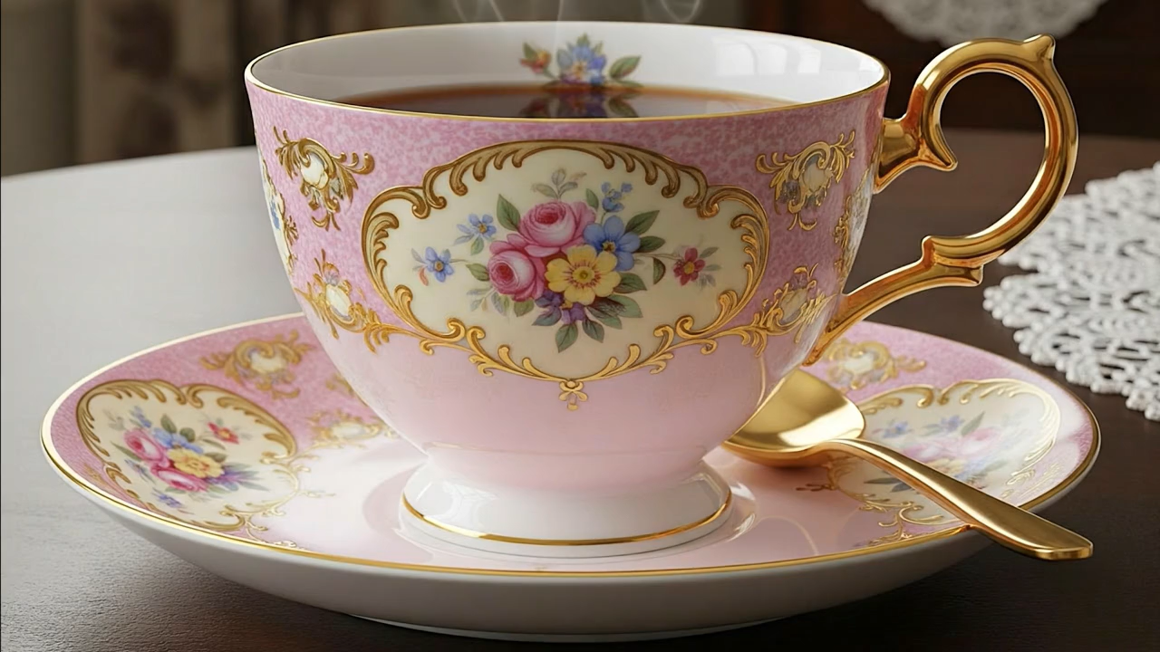
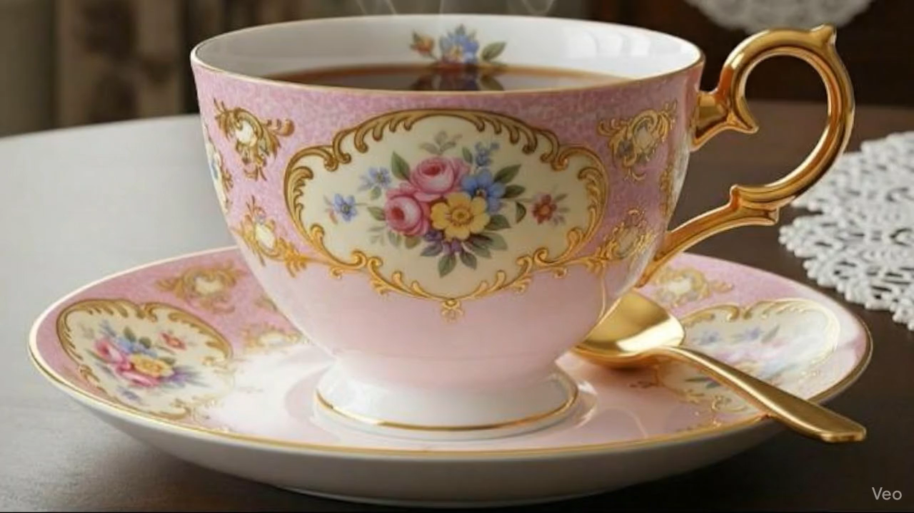
Task 1 : Transfiguration (Veo 3.1)
Prompt : “A magical spell smoothly transforms the structure of the teacup into a mouse.”

Slide 5
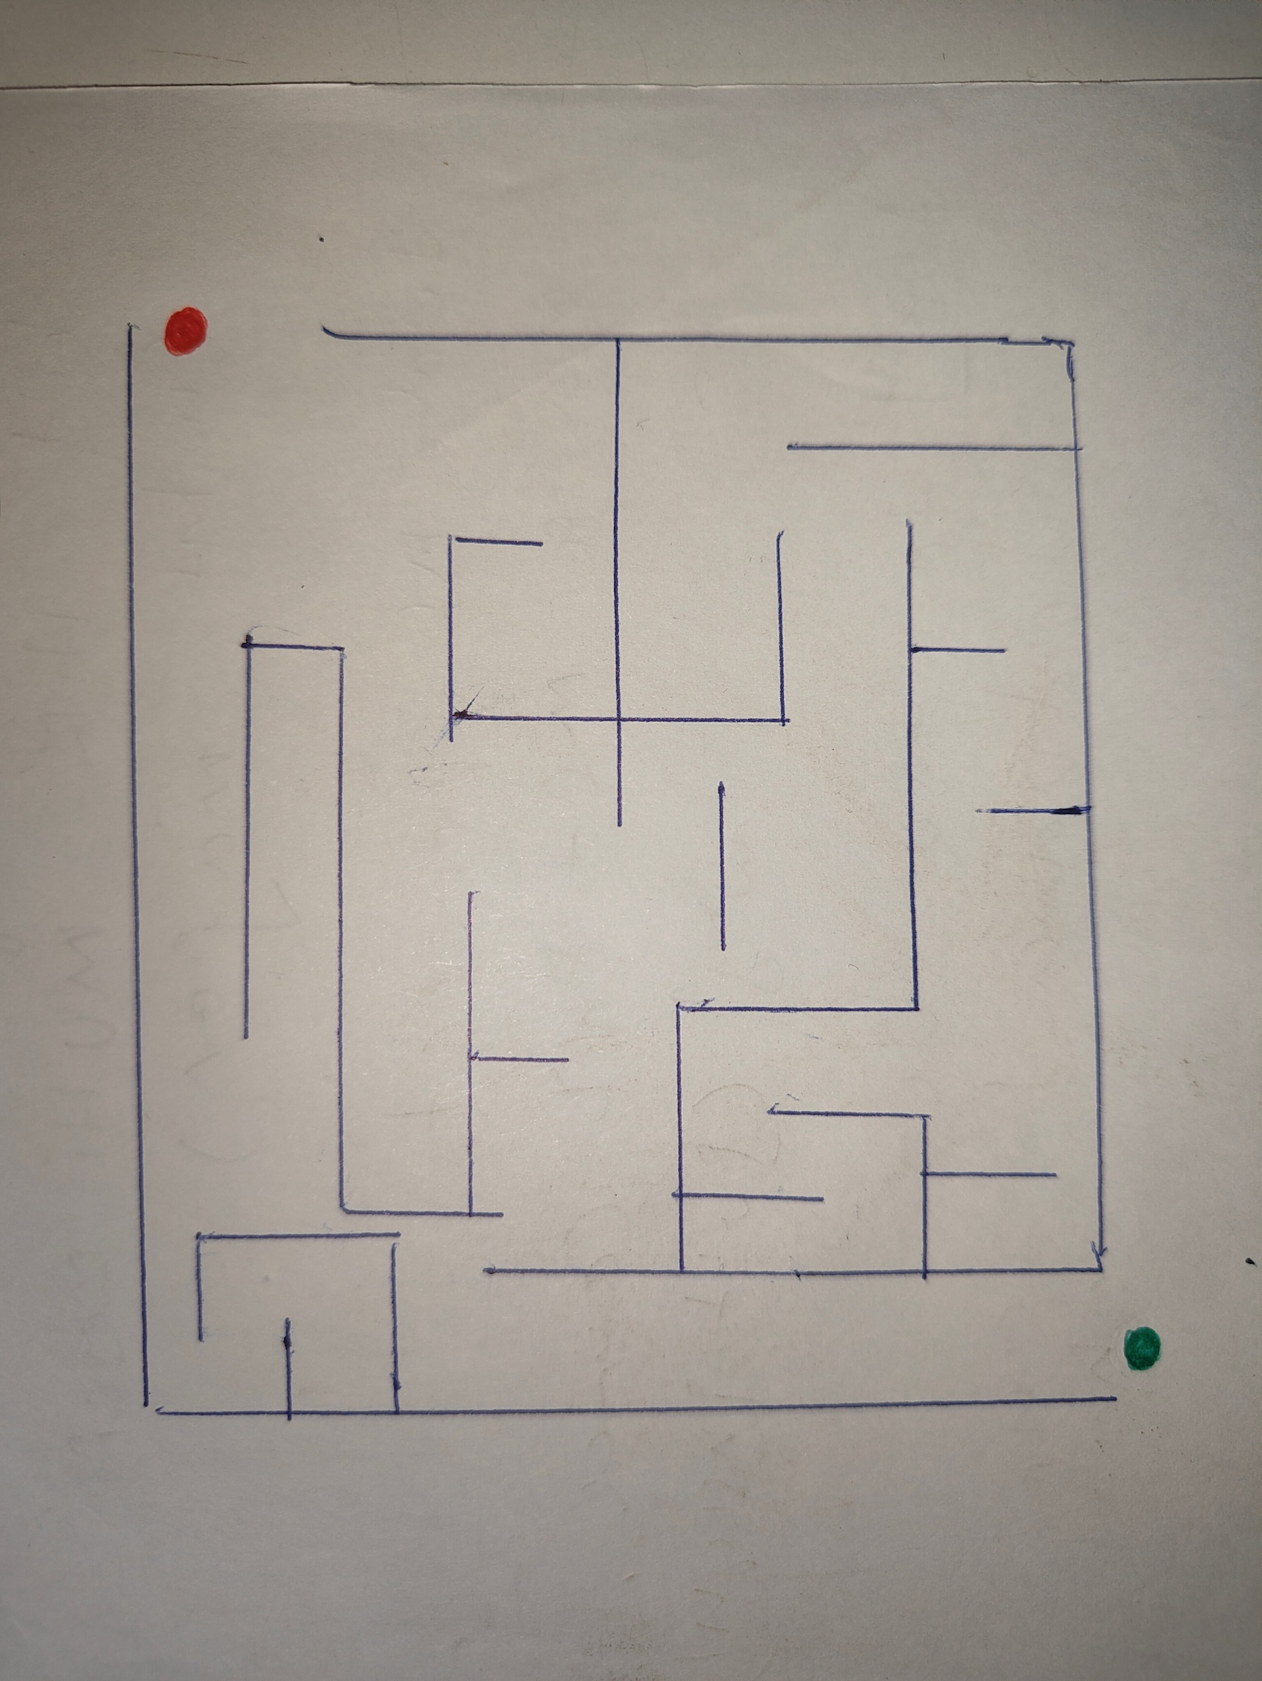
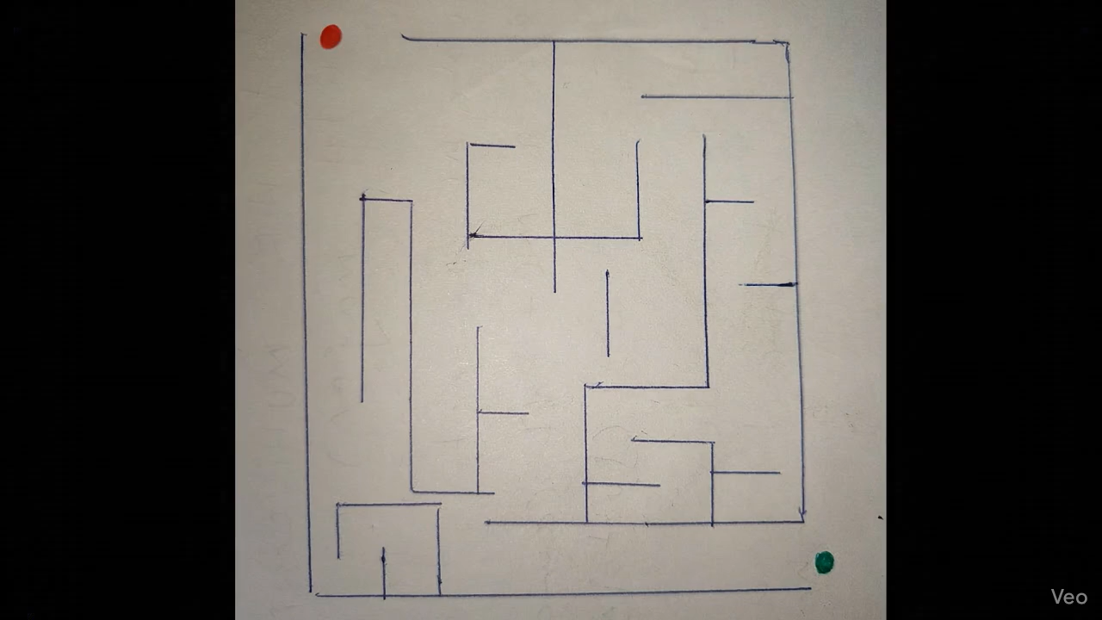
Task 2 : Maze Solving (Veo 3.1)
Prompt : “Create a 2D animation based on the provided image of a maze. The red circle slides smoothly along the path, stopping perfectly on the green circle. The red circle never slides or crosses into the lines once it enters the box of the maze.”

Slide 6
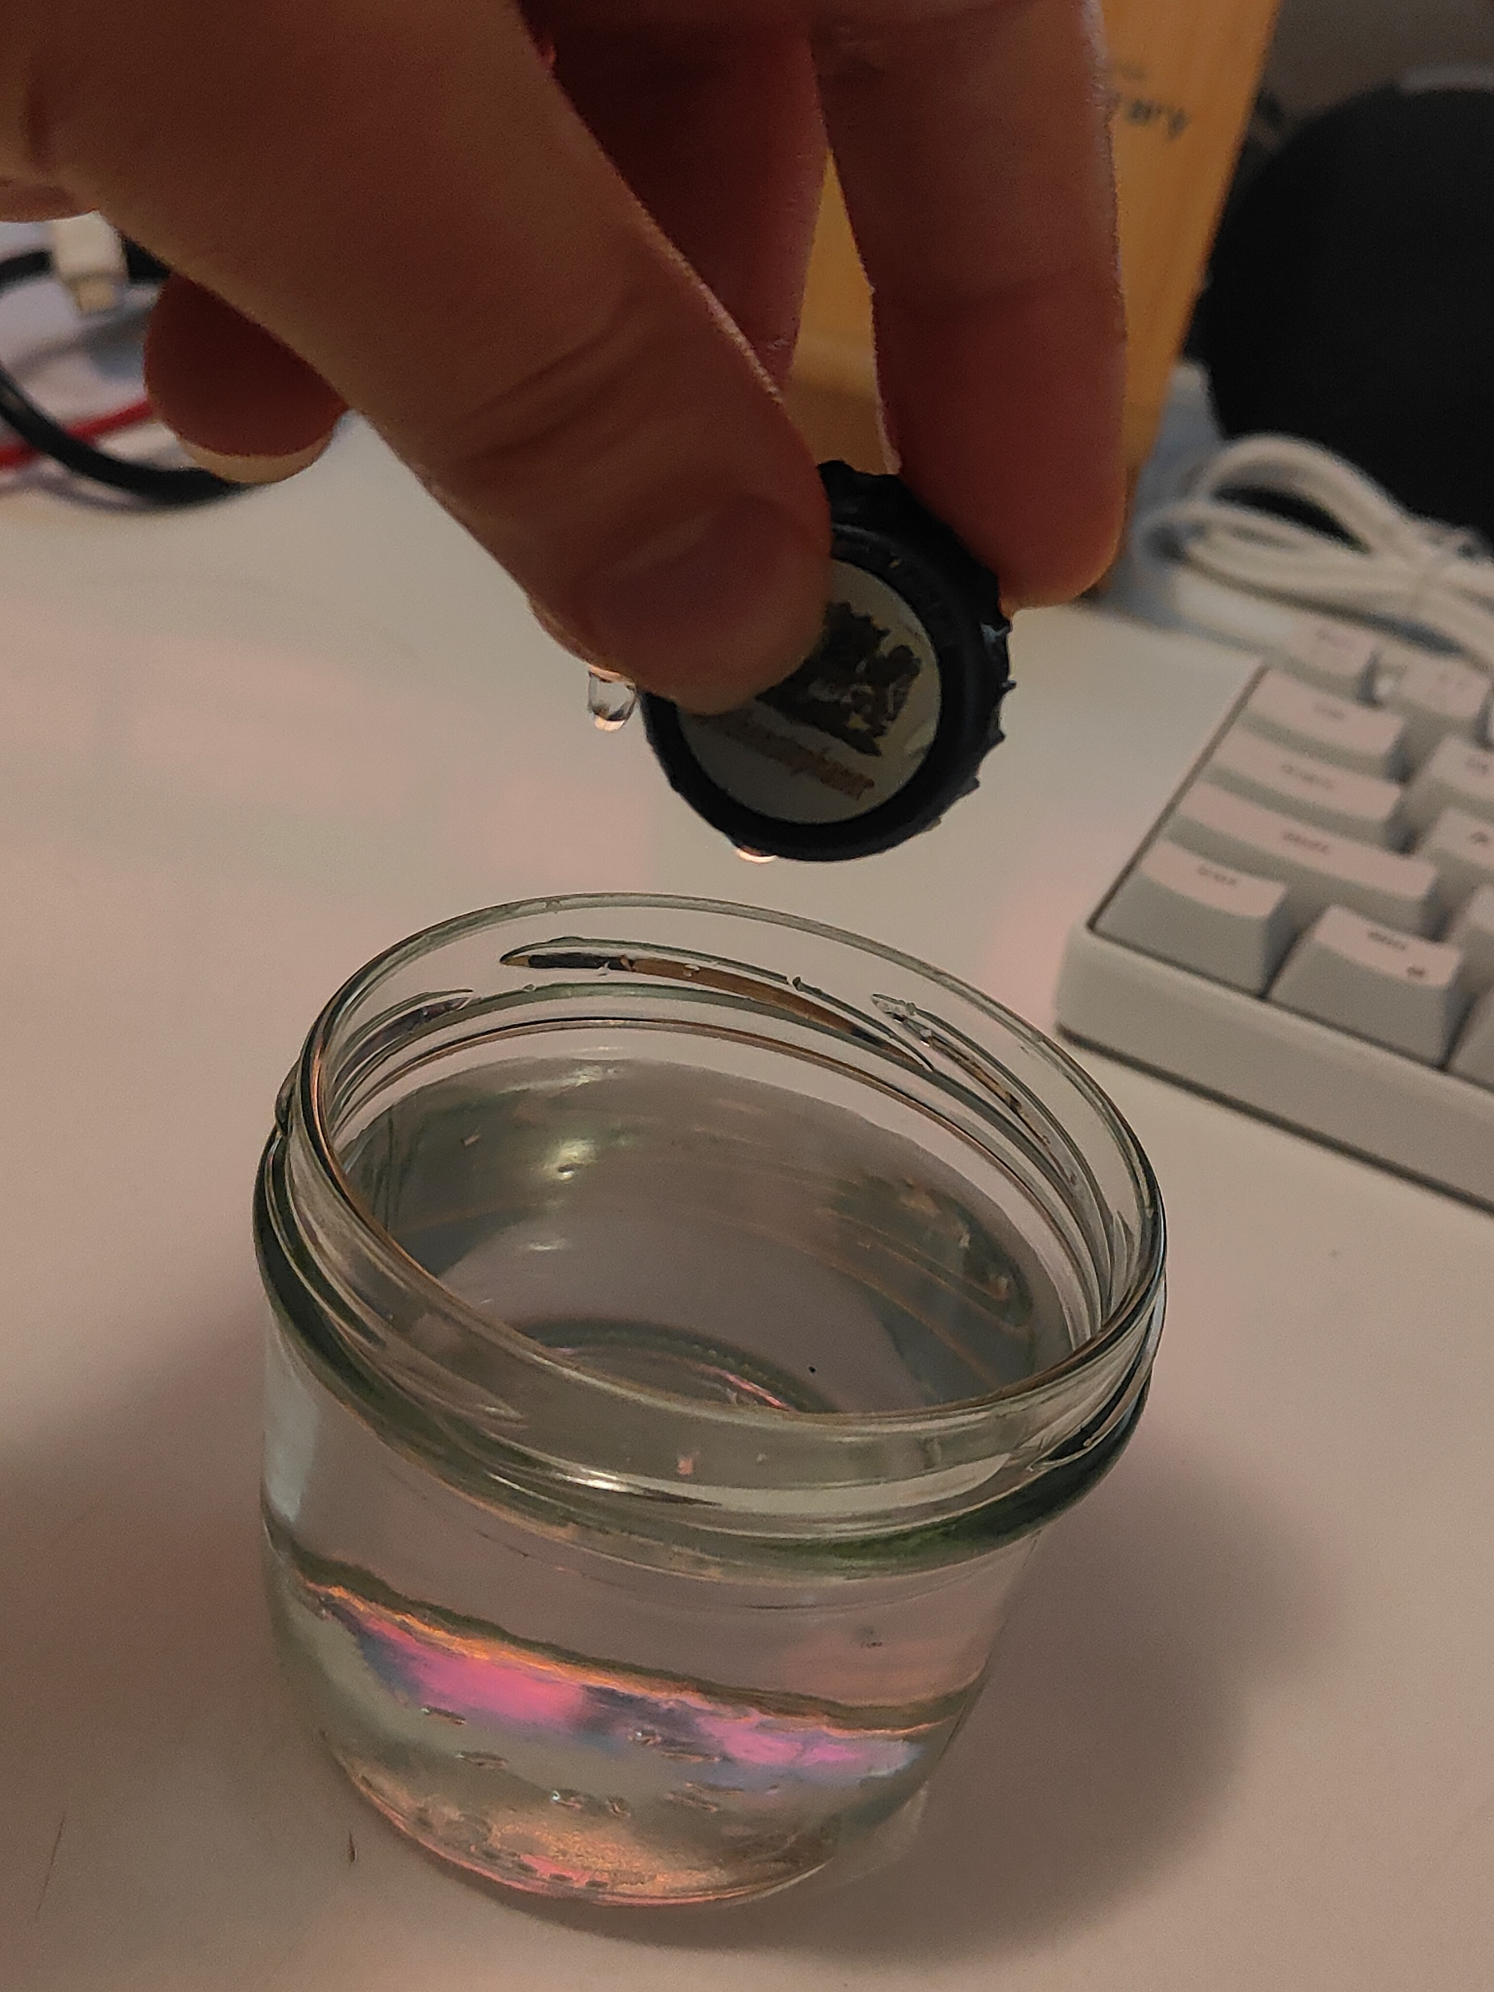
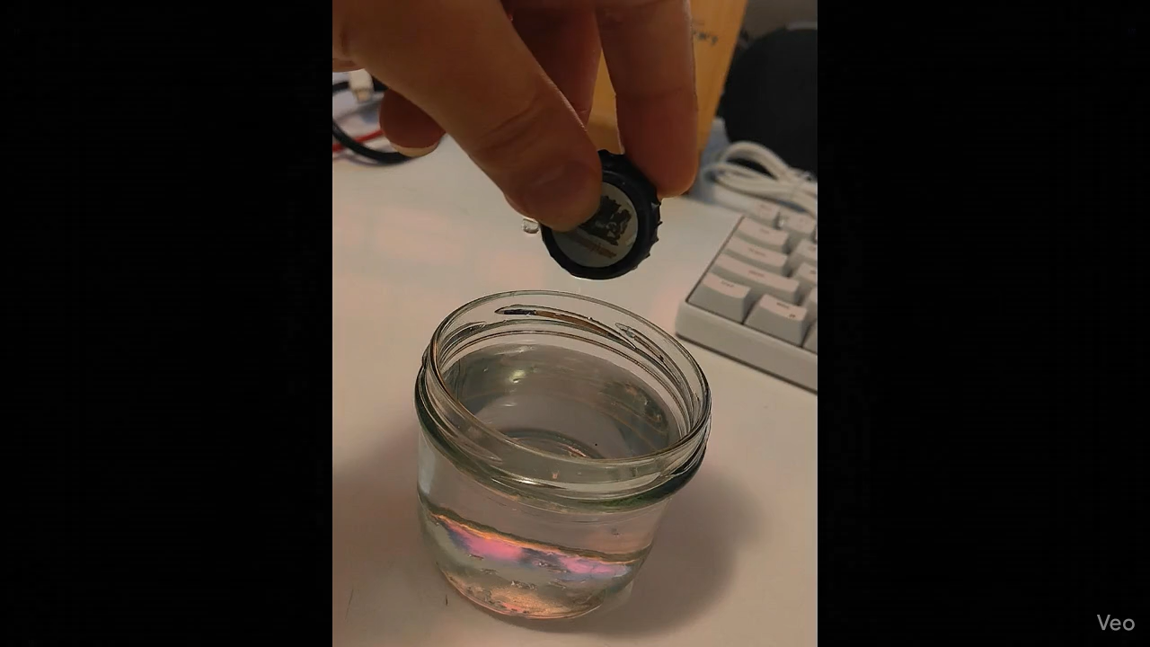
Task 2 : Physics (Veo 3.1)
Prompt : “The hand lets go of the object, the object falls in water. Static camera, no pan, no zoom, no dolly.”

Slide 7
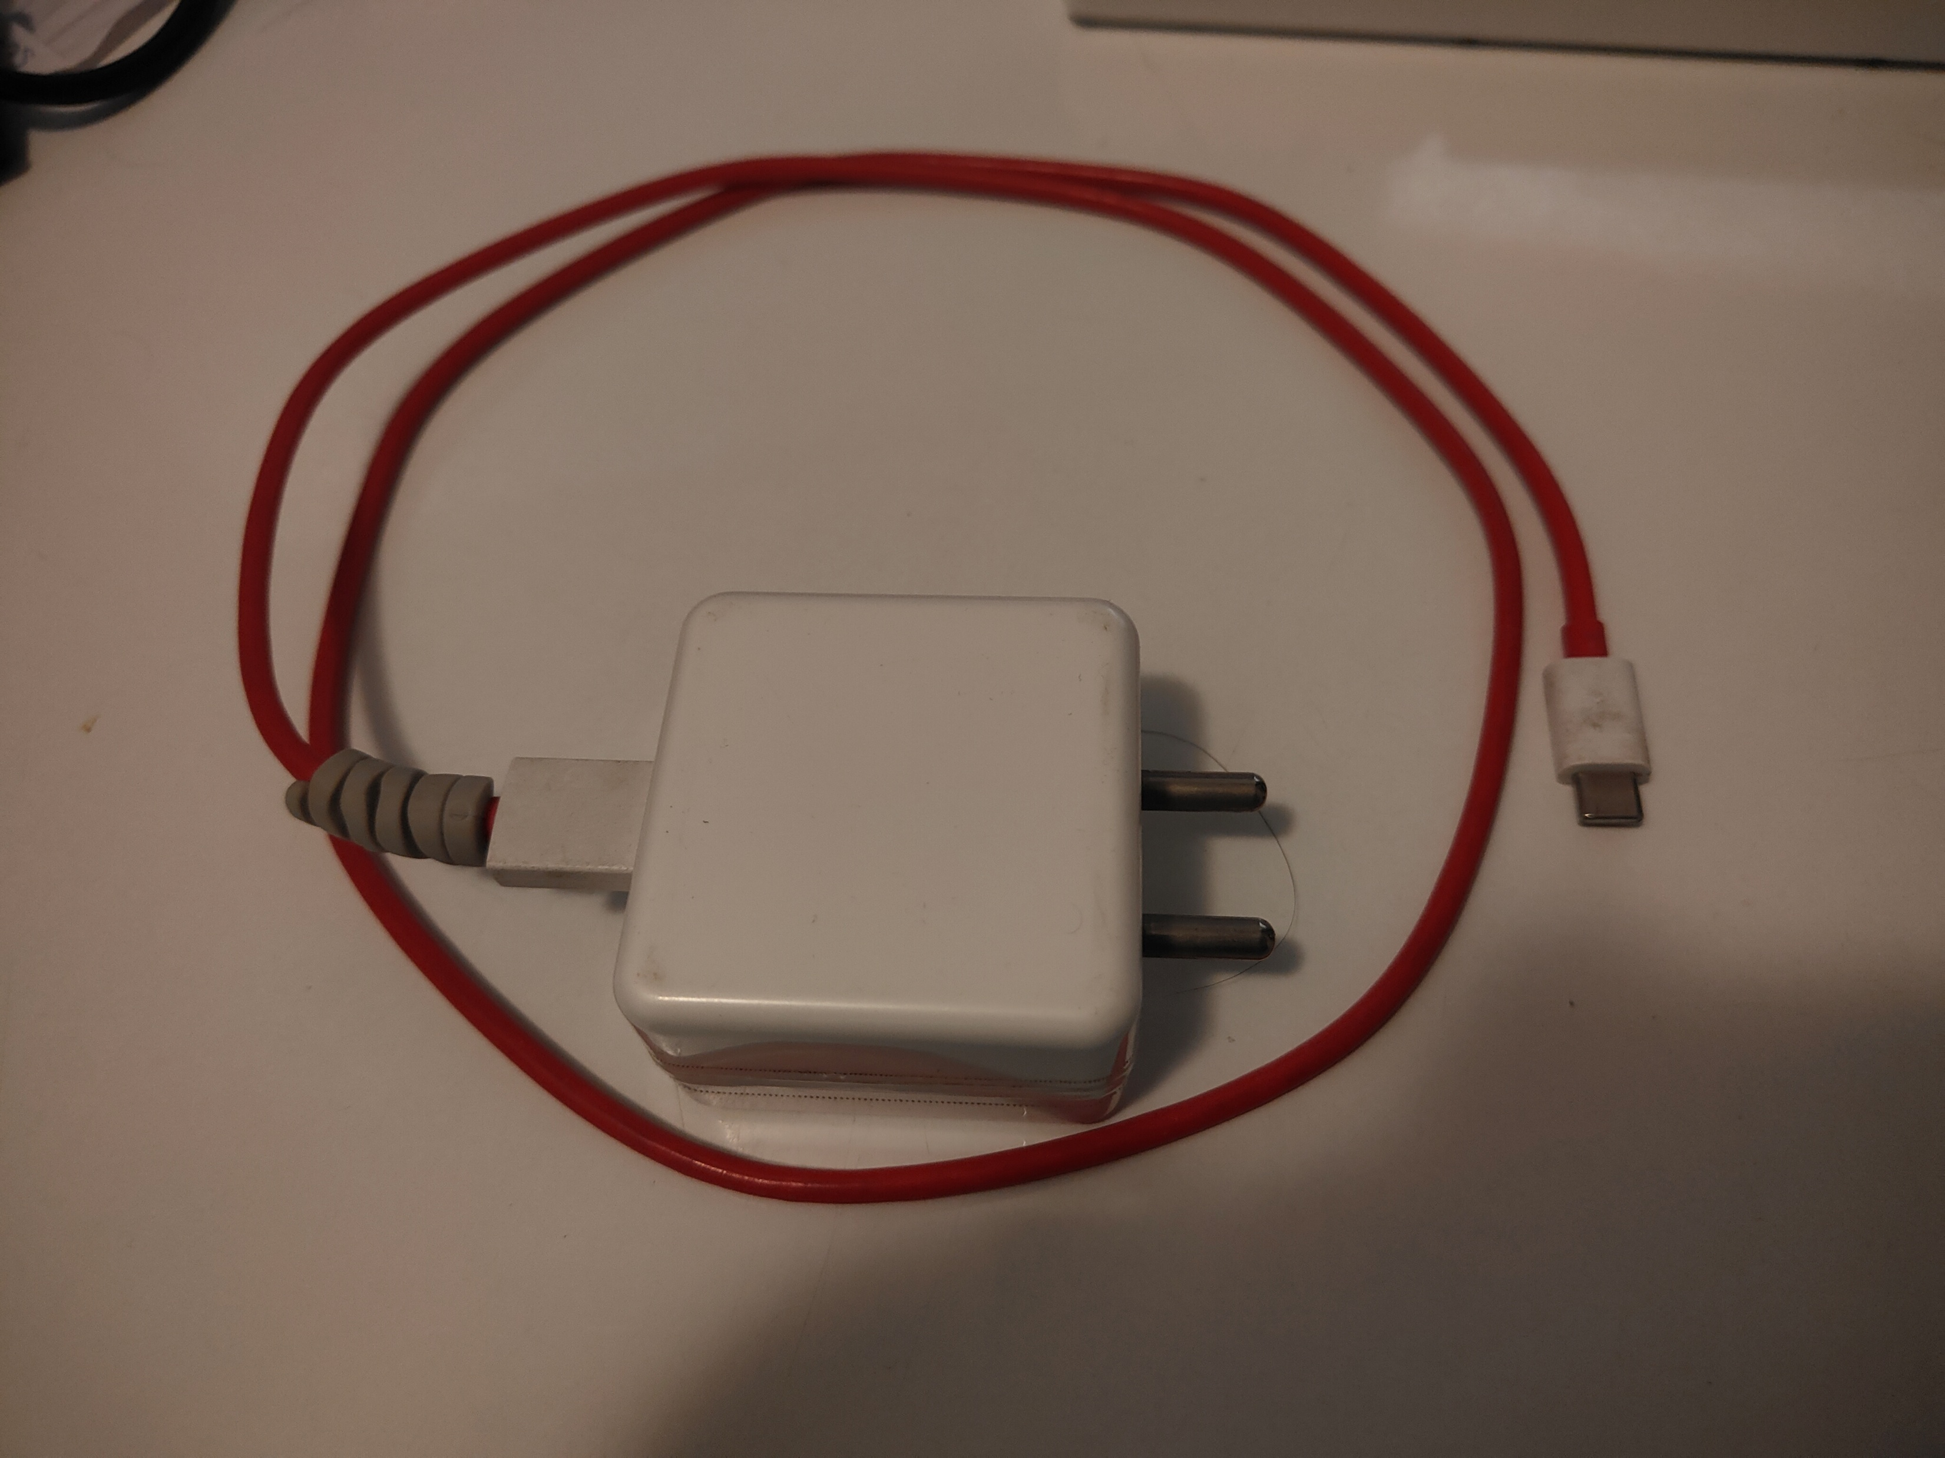
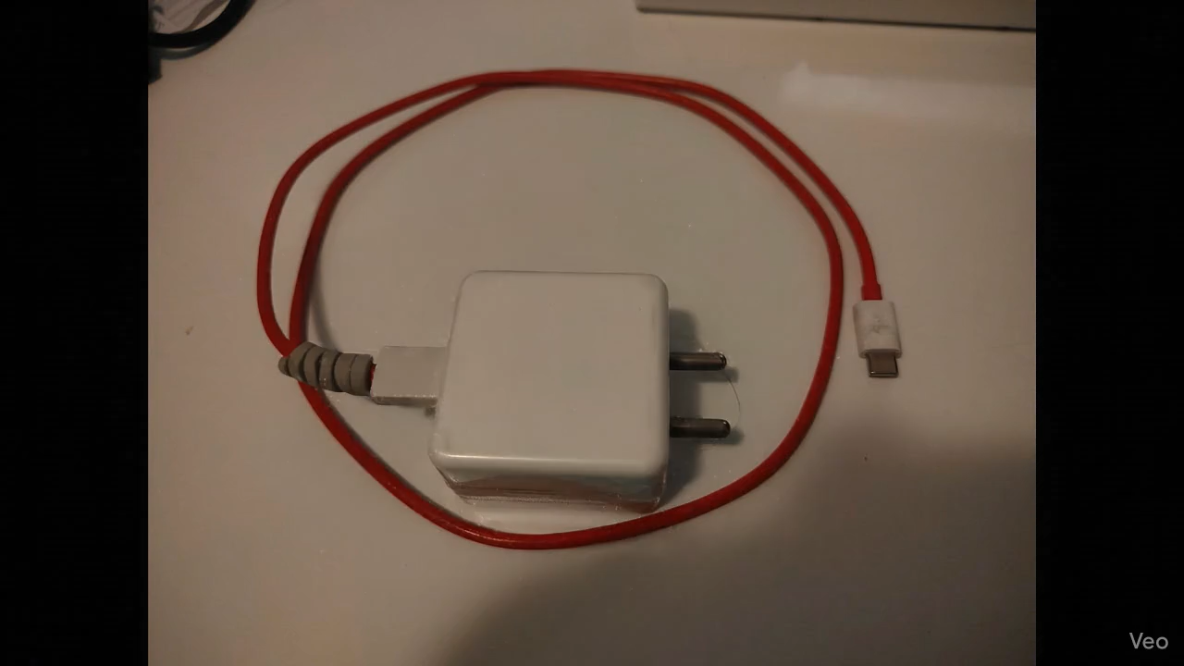
Task 2 : Transfiguration (Veo 3.1)
Prompt : “A magical spell smoothly transforms the structure of the charger into an elephant.”

Slide 8
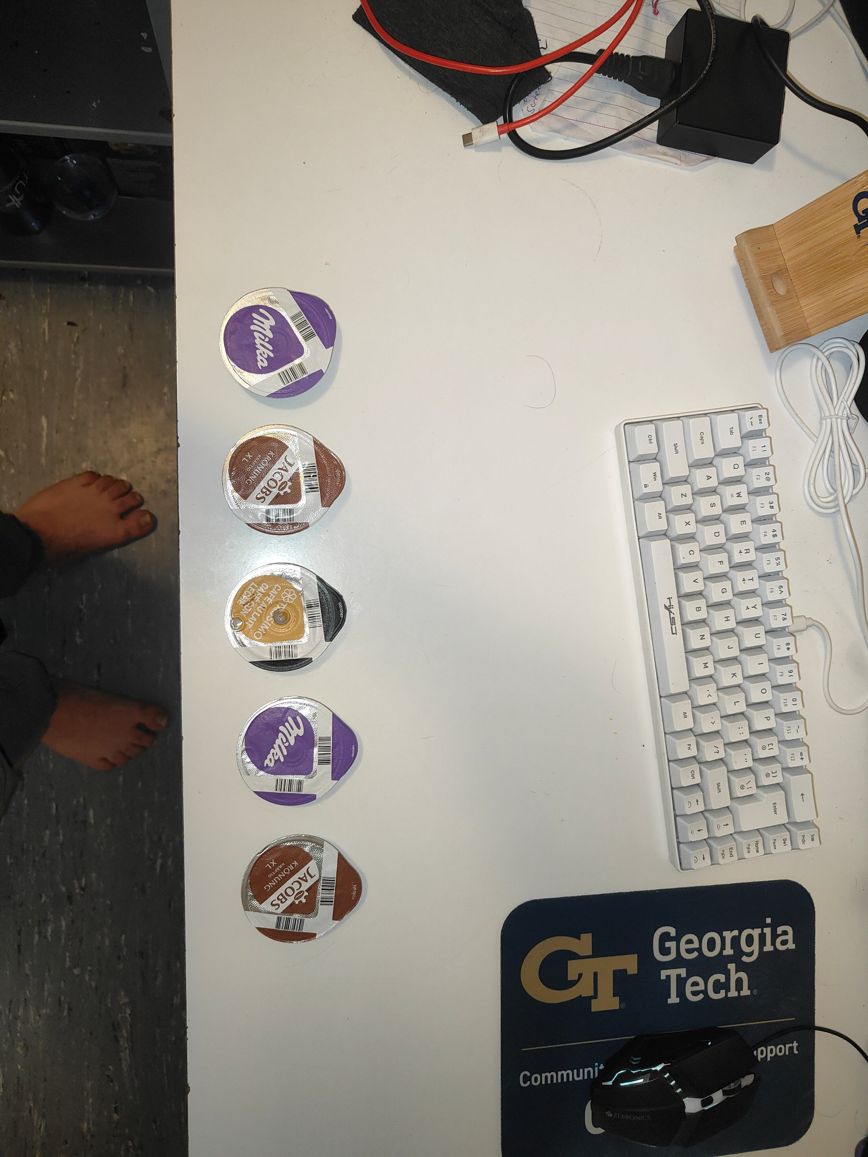
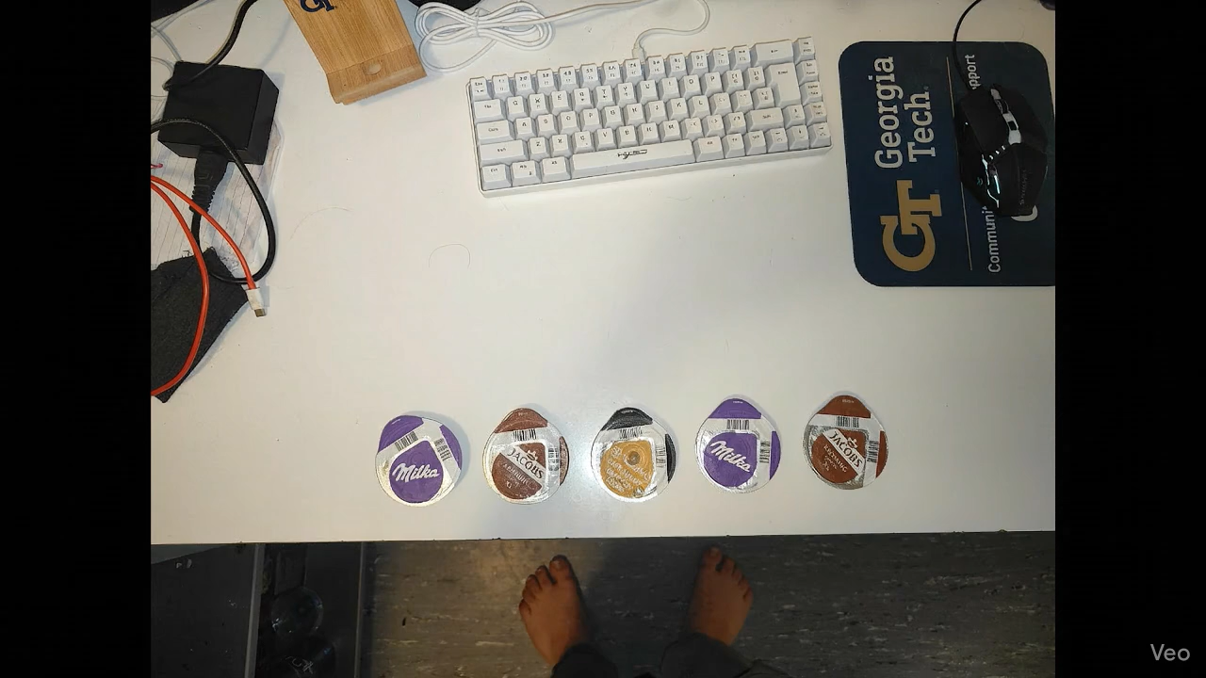
Task 3 : Object Motion and counting (Veo 3.1)
Prompt : “The five coffee pods in the image spin in their position and then move from left to right on the table. All the objects remain distinct throughout the motion.”

Slide 9

Task 4 : Maze Solving (Veo 2)
Prompt : “Create a 2D animation based on the provided image of a maze. The red circle slides smoothly along the white path, stopping perfectly on the green circle. The red circle never slides or crosses into the black areas of the maze.”

Slide 10

Task 4 : Physics (Veo 4)
Prompt : “The hand lets go of the object, the object falls in water. Static camera, no pan, no zoom, no dolly.”

Slide 11

Task 4 : Transfiguration (Veo 2)
Prompt : “A magical spell smoothly transforms the structure of the teacup into a mouse.”

Slide 12
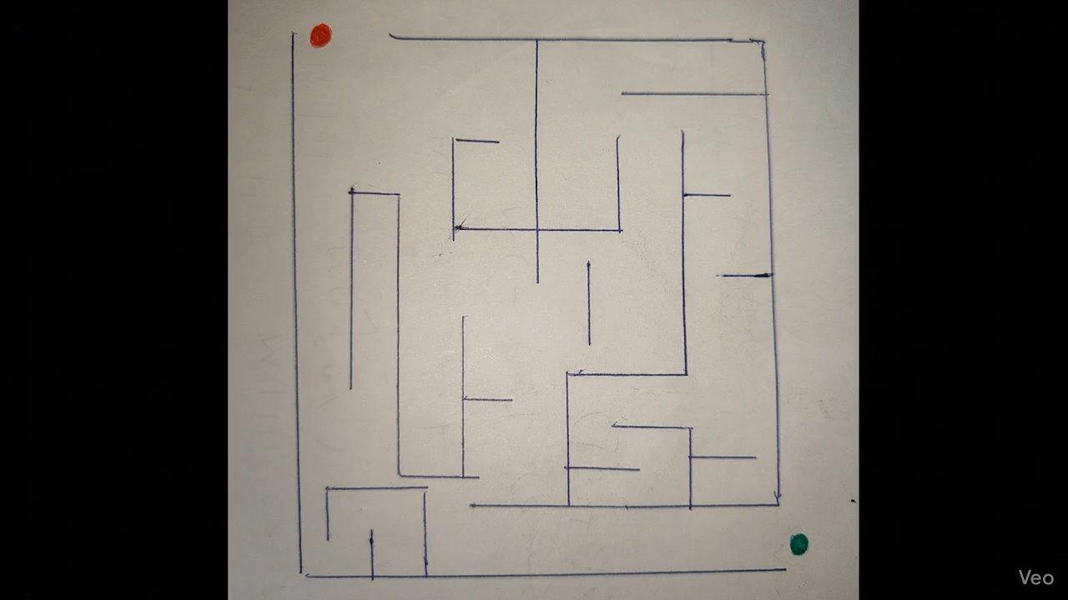
Task 4 : Maze Solving (Veo 2)
Prompt : “Create a 2D animation based on the provided image of a maze. The red circle slides smoothly along the path, stopping perfectly on the green circle. The red circle never slides or crosses into the lines once it enters the box of the maze.”

Slide 13
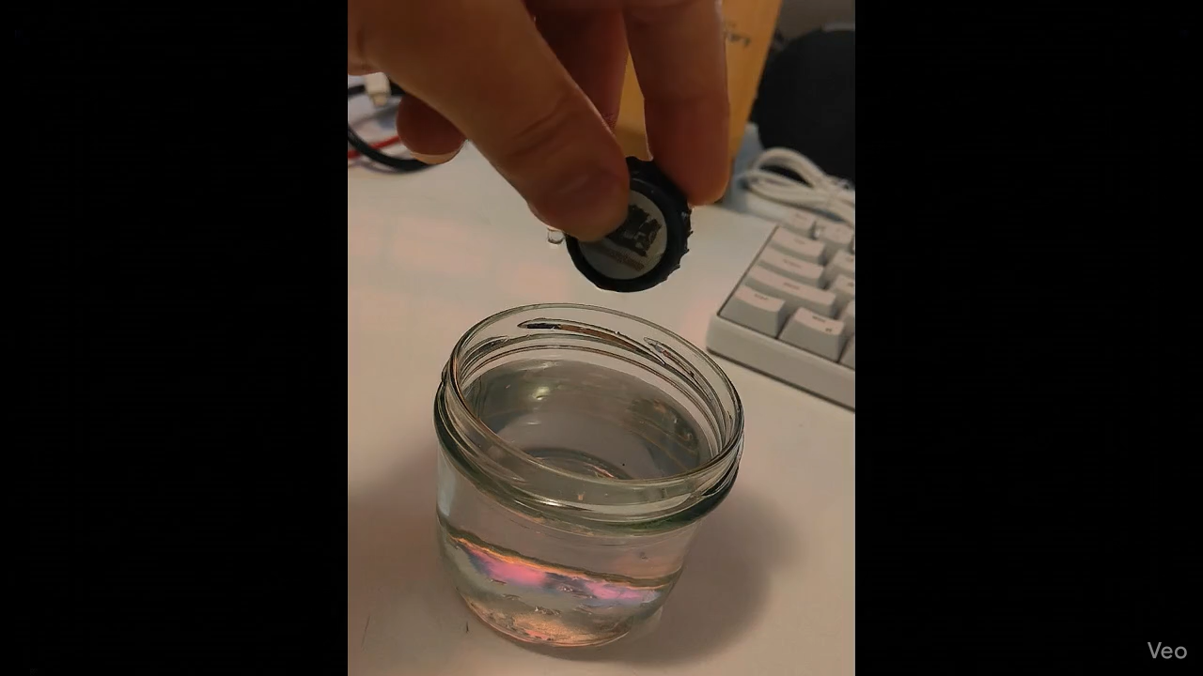
Task 4 : Physics (Veo 2)
Prompt : “The hand lets go of the object, the object falls in water. Static camera, no pan, no zoom, no dolly.”

Slide 14

Task 4 : Transfiguration (Veo 2)
Prompt : “A magical spell smoothly transforms the structure of the charger into an elephant.”

Slide 15
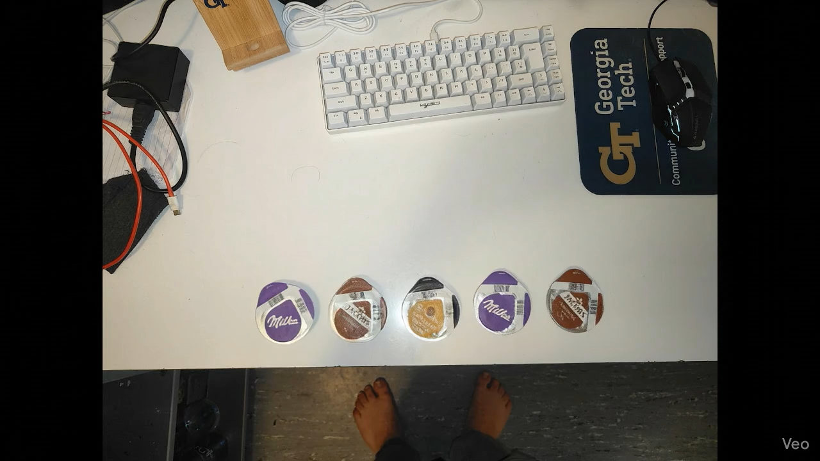
Task 4: Object Motion and counting (Veo 2)
Prompt : “The five coffee pods in the image spin in their position and then move from left to right on the table. All the objects remain distinct throughout the motion.”

Slide 16

Task 5: Maze Solving (Veo 3.1) without Prompt rewriting
Prompt : “Create a 2D animation based on the provided image of a maze. The red circle slides smoothly along the white path, stopping perfectly on the green circle. The red circle never slides or crosses into the black areas of the maze.”

Slide 17

Task 5 : Physics (Veo 3.1) without Prompt rewriting
Prompt : “The hand lets go of the object, the object falls in water. Static camera, no pan, no zoom, no dolly.”

Slide 18

Task 5 : Transfiguration (Veo 3.1) without Prompt rewriting
Prompt : “A magical spell smoothly transforms the structure of the teacup into a mouse.”

Slide 19


Task 5 : Maze Solving (Veo 3.1) without Prompt rewriting
Prompt : “Create a 2D animation based on the provided image of a maze. The red circle slides smoothly along the path, stopping perfectly on the green circle. The red circle never slides or crosses into the lines once it enters the box of the maze.”

Slide 20

Task 5 : Physics (Veo 3.1) without Prompt rewriting
Prompt : “The hand lets go of the object, the object falls in water. Static camera, no pan, no zoom, no dolly.”

Slide 21


Task 5 : Transfiguration (Veo 3.1) without Prompt rewriting
Prompt : “A magical spell smoothly transforms the structure of the charger into an elephant.”

Slide 22

Task 5 : Object Motion and counting (Veo 3.1) without Prompt rewriting
Prompt : “The five coffee pods in the image spin in their position and then move from left to right on the table. All the objects remain distinct throughout the motion.”

Slide 23
Summary / Inferences
The performance of Veo 3.1 was excellent and mostly successful when compared to Veo 2.
There was a significant performance drop when prompt rewriting was turned off for Veo 3.1 and cases where it was successful previously had now failed.
When testing maze solving capabilities, to test spatial reasoning, the reproduction on Veo 3.1 was successful but was only partially successful when given a variant of similar test, the failure was even more significant with prompt rewriting turned off and it failed completely on the Veo 2 model both on the variants and reproductions.
Physics test case for cap falling had similar results, while the reproductions were mostly successful with slight difference in interactions, the variants performance changed with prompt rewriting turned off and it hallucinated another cap on Veo 2 model.
Transfiguration was mostly unsuccessful while the reproductions were still acceptable it failed on Veo 2 and the variant cases were not consistent, interestingly the best performance was observed with prompt rewriting turned off in the variant case.
The object counting case was a bag of mixed results and all of them were unsuccessful, initially the coffee pods were moving as expected but one merged in the Veo 3.1 case. In the Veo 2 case the model hallucinated a train of pods, the last case the model merged all of the pods together and formed a bigger pod but the motion in this case was as expected over others.

Slide 24
Failure Cases
Despite their generalist capabilities, video models exhibit distinct failure modes when pushed beyond simple generation. Physics violations are common, models often prioritize visual smoothness over physical plausibility, causing objects to clip through walls as seen in the maze task, float unnaturally.
Hallucinations also occur, particularly in tasks requiring object permanence where objects may spontaneously merge, disappear, or multiply during occlusion.
Furthermore, the models show a heavy dependence on prompt rewriting; when the internal LLM rewriter is disabled, performance on reasoning tasks (like pathfinding) degrades significantly, revealing that the "intelligence" often lies in the text encoder rather than the video generation process itself

